Slide 1
Introduction to international logistics Introduction lesson
Fiona koevoets
Logistics Engineering
Academic year 2018-2019

Slide 2

Fiona Koevoets
Bachelor of Business Administration
-> HZ University of Applied Sciences,
Vlissingen, NL
Master of Business Administration
-> University of Humberside, Hull, UK
International logistics experience:
-> TNT (Spain)
-> Van Gend & Loos
-> DHL

Slide 3
TODAY
Overview subjects year 1
Competences
Lesson planning
Examination
Explanation of ‘My HZ’
Study book
What is logistics
What do you know about logistics in your country?
Logistics terminology
Homework

Slide 4
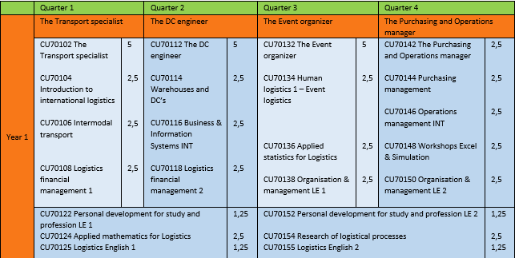
Overview subjects year 1
1 EC = 28 study hours (average) -> 70 study hours for this course!

Slide 5
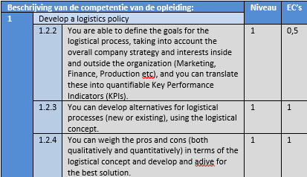
Competences

Slide 6
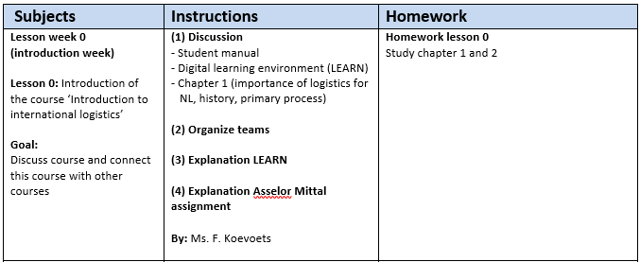
Lesson planning

Slide 7
Examination
PRODUCT | DESCRIPTION | WEIGHT | MINIMUM SCORE
Written exam | Multiple choice questions | 100% | 5,5 (on scale of 1-10)

Slide 8
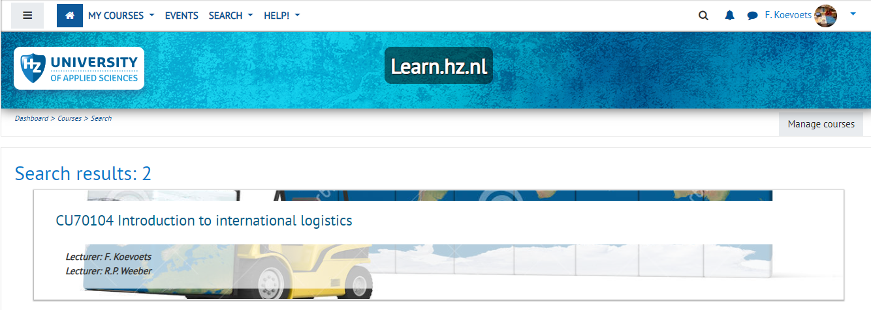
Explanation of My HZ
Log in My HZ (my.hz.nl)
Find CU70104 Introduction to international logistics end of this week

Slide 9
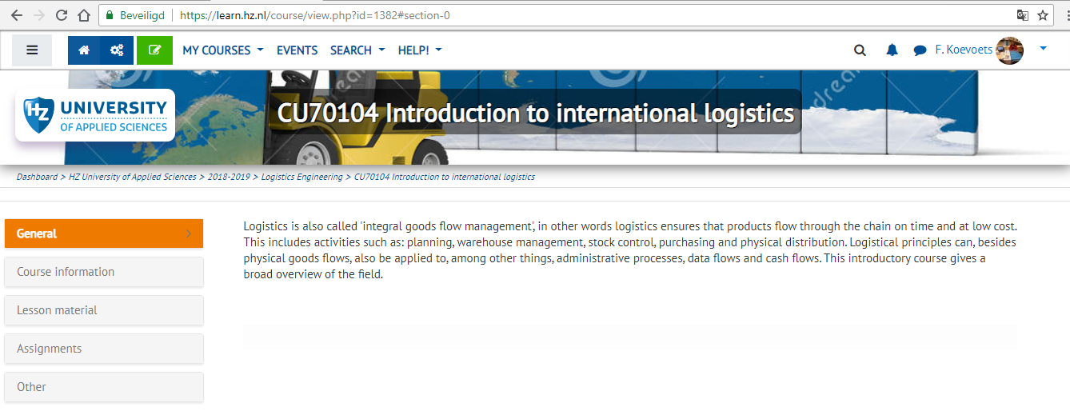
Explanation of My HZ

Slide 10
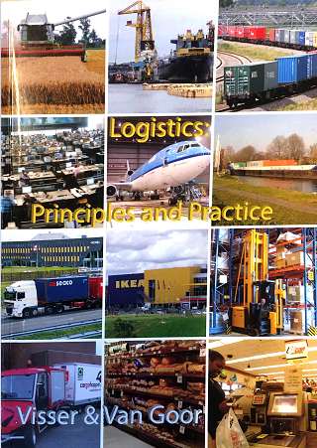
Study book

Slide 11
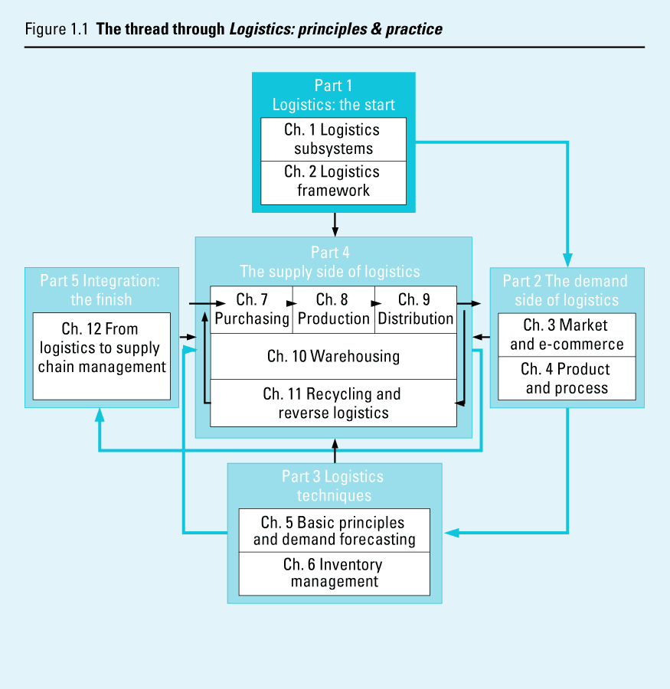
Study book

Slide 12
What is logistics?
Definition:
Logistics entails the organization, planning, control and execution of the flow of goods from development and purchasing, through manufacturing and distribution to the consumer (end user), up to and including the reverse flow.
The aim is to meet market demand at lowest costs and best use capital, and build long term relationships with customers.

Slide 13
History of logistics
Military roots
Change to integration philosofy
Change of customers wish
Globalisation of world market
leadtime and cost savings

Slide 14
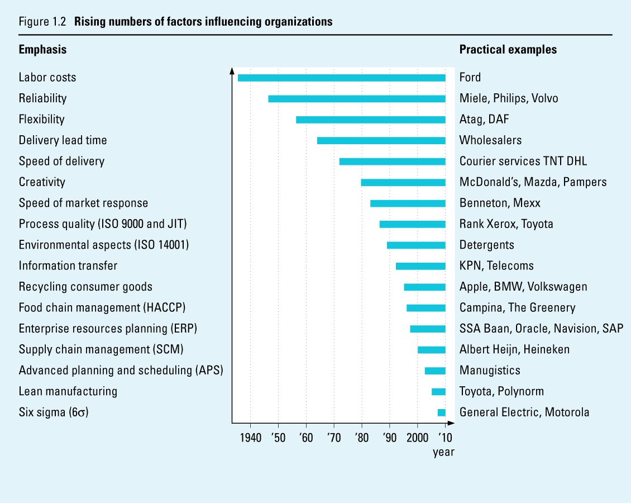
Rising numbers of factors influencing organisations

Slide 15
Logistics in the Netherlands
The Netherlands, topsector of logistics
Number 5 on toplist
More innovation is needed
Gouvernement investments infrastructure, innovation etc.

Slide 16
Assignment in the classroom
Choose a partner from ANOTHER COUNTRY.
Each partner describes the state of transport and logistics in his/her own country:
transport and logistics as an industrial branch
economical importance
transport and ICT infrastructure
logistics profession
logistics research and education
etc.

Slide 17
Recognize the primary flow of an organization
Black box/system approach:
throughput
input
output

Slide 18
Assignment in the classroom
What does the primary proces look like at a :
A blast-furnace
A hospital
A movement company
A machine factory

Slide 19
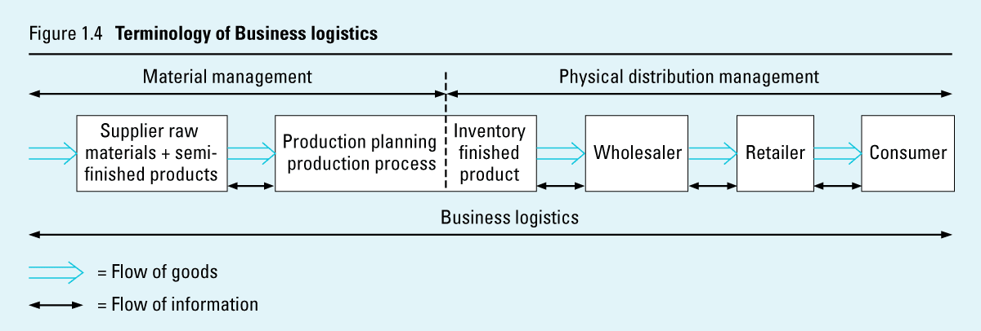
Logistics terminology

Slide 20
Basic logistics symbols
Begin or end of a flow (goods, information, etc.)
Represents a process
Represents a stock/ storage point
Represents the flow of goods
Represents the flow of information
Represents the flow of money

Slide 21
Homework
Read chapter 1 & 2 + student guide (course description)

